Slide 1
The Project and Data Management (PDM) Plan
Nazmul Hossain, 23015862
https://github.com/nazmul-nil/MSc-DS-Research-Project-UH

Slide 2
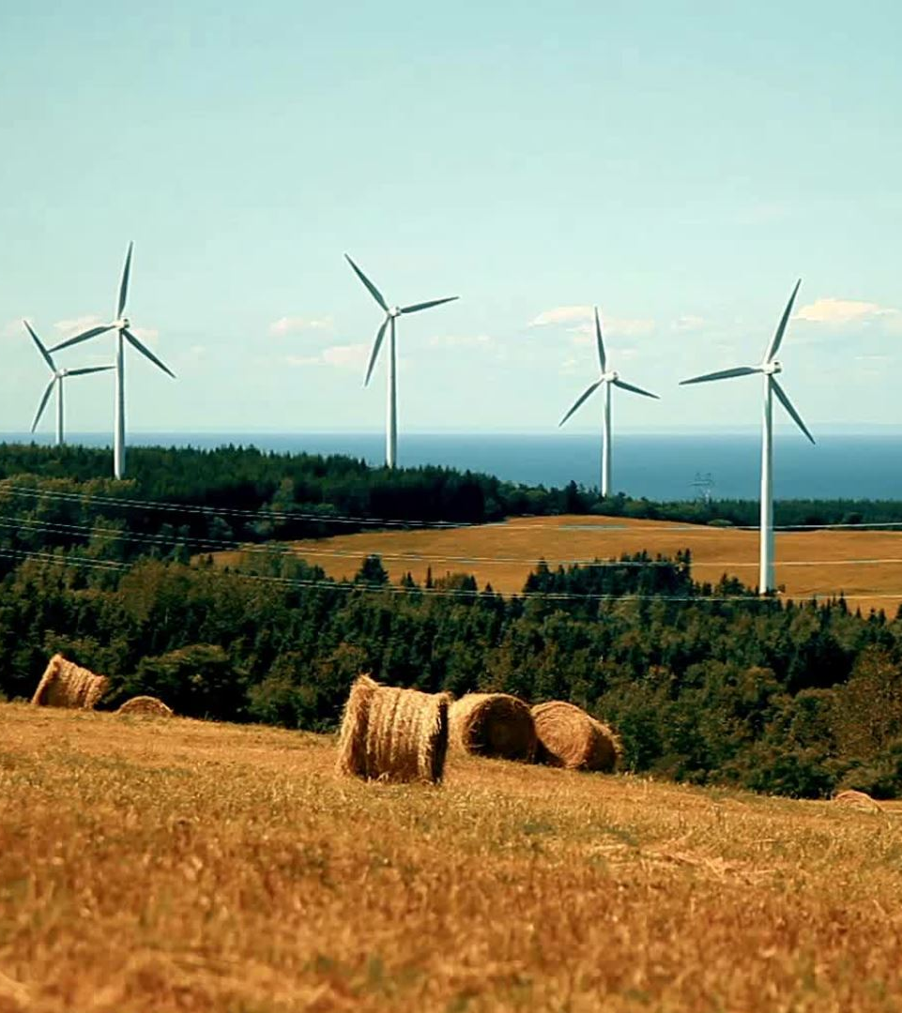
Project Title
''Exploring Renewable Energy and Energy Efficiency Impacts on Sectoral Economic Growth in Low- and Middle-Income Countries.''

Slide 3
Research Question
What is the role of renewable energy adoption and energy efficiency in shaping sectoral economic growth (agriculture, industry, and services) in low- and middle-income countries with varying CO2 emissions levels?

Slide 4
Project Summary:
This study aims to examine how reusable energy adoption and energy efficiency influence economic growth in different sectors, including agriculture, industry, and services. By analyzing data from developing and emerging economies, the study will offer an understanding of the significance of sustainable energy in shaping sectoral development.

Slide 5
Objectives:
Perform exploratory data analysis to identify trends in renewable energy adoption and CO2 emissions.
Apply statistical regression models to assess the effect of renewable energy and energy efficiency on sectoral GDP.
Clustering techniques to group countries by energy and economic performance.
Validate the findings with appropriate statistical and data science methods.
Draft policy recommendations based on research insights.

Slide 6
Background
The increasing urgency to address climate change and attain sustainable development has directed global attention toward renewable energy adoption and energy efficiency. Reusable energy resources like hydroelectric power, wind, and solar contribute to mitigating emissions of greenhouse gases while at the same time supporting growth in GDP (Sadorsky, 2009). Additionally, improvements in energy efficiency, often measured through energy intensity, are essential for decoupling economic growth from environmental degradation (Rajbhandari and Zhang, 2018). However, there is still limited research on how these factors impact economic growth by sector—particularly in nations with limited and moderate financial resources (Acheampong, 2018). Our research aims to bridge this difference by examining the part of renewable energy and energy efficiency in shaping sectoral GDP growth as well as providing evidence-based policy recommendations.

Slide 7
Project Plan
Table 1: Task Timeline
Weeks | Project Tasks
1–4 (12th Feb) | PDM Plan + Dataset Exploration (Check missing values, structure).
3–6 (26th Feb) | Literature Review (10–15 papers).
6–8 (12th Mar) | Start EDA + Finalize methodology.
8–10 (26th Mar) | Full Data Analysis.
10–12 (9th Apr) | Results Interpretation + Draft Report
12–14 (23rd Apr) | Refine Report, Finalize Results & Presentation.
15 (29th Apr) | Submit Final Report.

Slide 8
Data Management Plan
Data:
Source: World Development Indicators (World Bank). Includes multiple countries from 1989–2023.
Description: Includes indicators for renewable energy (% of total energy), energy efficiency (energy intensity), CO2 emissions (metric tons per capita), and GDP contributions by sector (agriculture, industry, services).
Shape: (24211, 39)

Slide 9
Data Management Plan
Data Collection: The dataset was collected from the World Bank’s main assembly of growth metrics, which is World Development Indicators, with series selected from three subcategories within Economic Policy & Debt (Growth Rates) and Environment (Emissions, and Energy Production & Use). (World Bank, 2025)

Slide 10
Data Management Plan
Ethical Requirements:
GDPR Compliance: The dataset is publicly available from the World Bank and does not include any information that can be used to identify individuals.
UH Ethics Policy: The project follows UH ethical policies by ensuring the dataset is open-access and publicly licensed.
Permission for Use: The World Development Indicators dataset is open-source and allows usage for academic research.
Data Collection Ethics: The dataset was collected by official global agencies (World Bank, UN, IEA, IMF), ensuring validity and ethical sourcing.

Slide 11
Data Management Plan
Metadata:
Format: CSV Files
Size: Approx. 10MB
Records: 24211 rows, 39 columns.

Slide 12
Data Management Plan
Storage: All data and code will be pushed into the GitHub repository. The project will be stored in OneDrive as a backup (OneDrive Link).
Version Control: GitHub will track code development and ensure versioning. GitHub Repository: https://github.com/nazmul-nil/MSc-DS-Research-Project-UH
ReadMe File: The ReadMe file will include the Project Title, Project Overview, Dataset Description, Folder Structure, Requirements, Collaboration, License etc.

Slide 13
Reference Lists
Acheampong, A. O. (2018). Economic growth, CO₂ emissions, and energy consumption: What causes what and where? Energy Economics, 74, pp. 677–692. Available at: https://doi.org/10.1016/j.eneco.2018.07.022. (Accessed: 28 January 2025).
Hossain, N. (2025). Investigating the Effects of Renewable Energy and Energy Efficiency on Economic Growth in Low- and Middle-Income Nations. [GitHub Repository]. Available at: https://github.com/nazmul-nil/MSc-DS-Research-Project-UH.
Rajbhandari, A., & Zhang, F. (2018). Does energy efficiency promote economic growth? Evidence from a multicountry and multisectoral panel dataset. Energy Economics, 69, pp. 128–139. Available at: https://doi.org/10.1016/j.eneco.2017.11.007. (Accessed: 30 January 2025).
Sadorsky, P. (2009). Renewable energy consumption and income in emerging economies. Energy Policy, 37(10), pp. 4021–4028. Available at: https://doi.org/10.1016/j.enpol.2009.05.003. (Accessed: 4 February 2025).
World Bank (2025). World Development Indicators. [Online]. Available at: https://databank.worldbank.org/source/world-development-indicators.

